Slide 1
Chapter 7: Deadlocks死锁

Slide 2
Deadlocks 死锁
7.1 System Model
7.2 Deadlock in Multithreaded Applications
7.3 Deadlock Characterization
7.4 Methods for Handling Deadlocks
7.5 Deadlock Prevention
7.6 Deadlock Avoidance
7.7 Deadlock Detection
7.8 Recovery from Deadlock

Slide 3
7.1 System Model

Slide 4
The Deadlock Problem
R1：左桥部分
R2：右桥部分
Traffic only in one direction.
Each section of a bridge can be viewed as a resource.
If a deadlock occurs, it can be resolved if one car backs up (preempt resources and rollback).
Several cars may have to be backed up if a deadlock occurs.
Starvation is possible.

Slide 5
The Deadlock Problem
Deadlock ：A set of blocked processes each holding a resource and waiting to acquire a resource held by another process in the set.
死锁：指多个进程因竞争共享资源而造成的一种僵局，若无外力作用，这些进程都将永远不能再向前推进
Example 1
System has 2 tape drives.
P₁ and P₂ each hold one tape drive and each needs another one.
Example 2
semaphores A and B, initialized to 1
P₀ P₁
wait (A); wait(B)
wait (B); wait(A)
How Deadlock ?

Slide 6
System Model
Resource types R₁, R₂, . . ., R_{m ：}
CPU cycles, memory space, I/O devices
Each resource type R_{i} has W_{i} instances.
Each process utilizes a resource as follows:
Request 申请
Use 使用
Release 释放

Slide 7
7.2 Deadlock Characterization

Slide 8

Deadlock Characterization
Necessary Conditions
Deadlock can arise if four conditions hold simultaneously. 产生死锁的四个必要条件：
Mutual exclusion（互斥）: only one process at a time can use a resource.
Hold and wait（占有并等待、请求和保持） : a process holding at least one resource is waiting to acquire additional resources held by other processes.
请求和保持(Hold and wait)条件：进程已经保持了至少一个资源，但又提出了新的资源要求，而该资源又已被其它进程占有，此时请求进程阻塞，但又对已经获得的其它资源保持不放

Slide 9
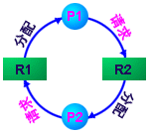
Deadlock Characterization (Cont.)
No preemption（不可抢占、不剥夺） : a resource can be released only voluntarily by the process holding it, after that process has completed its task.
Circular wait（循环等待）: there exists a set {P₀, P₁, …, P_{n}} of waiting processes such that P₀ is waiting for a resource that is held by P₁, P₁ is waiting for a resource that is held by P₂, …, P_{n–1} is waiting for a resource that is held by P_{n}, and P_{n} is waiting for a resource that is held by P₀.

Slide 10
Resource-Allocation Graph资源分配图
A set of vertices V and a set of edges E.
V is partitioned into two types:
P = {P₁, P₂, …, P_{n}}, the set consisting of all the processes in the system.
R = {R₁, R₂, …, R_{m}}, the set consisting of all resource types in the system.
request edge – directed edge P_{i} → R_{j}
请求边：P_{i} → R_{j}
assignment edge – directed edge R_{j} → P_{i}
分配边：R_{j} → P_{i}

Slide 11
Resource-Allocation Graph (Cont.)
Process
Resource Type with 4 instances (实例、个数)
P_{i} requests instance of R_{j}
P_{i} is holding an instance of R_{j}
P_{i}
R_{j}
P_{i}
R_{j}

Slide 12
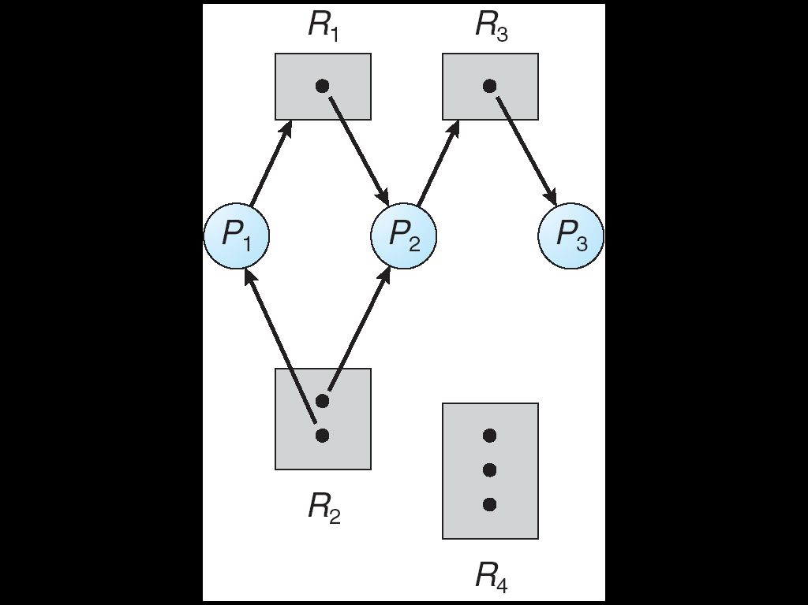
Example of a Resource Allocation Graph

Slide 13
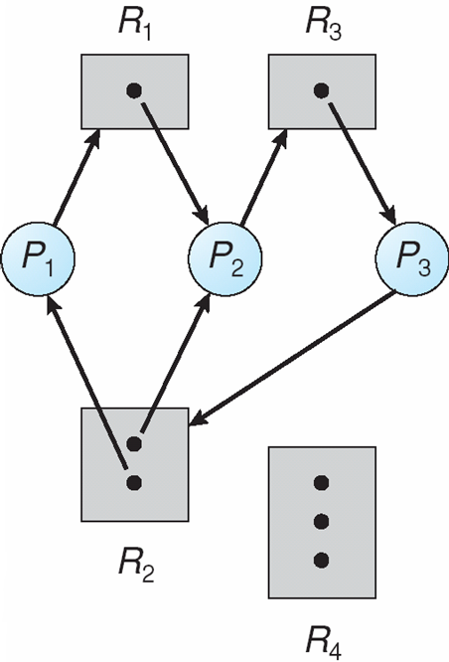
Resource Allocation Graph With A Deadlock

Slide 14
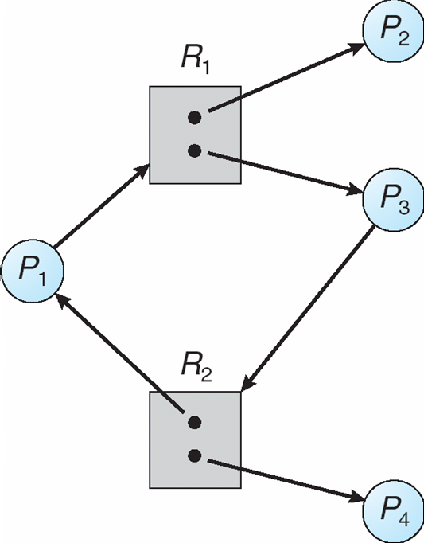
Resource Allocation Graph With A Cycle But No Deadlock

Slide 15
Basic Facts
If graph contains no cycles ⇒ no deadlock.
If graph contains a cycle ⇒
if only one instance per resource type, then deadlock.
if several instances per resource type, possibility of deadlock.
死锁定理：S为死锁状态的充分条件是：尚且仅当S状态的资源分配图是不可完全简化的。
资源分配图（有向图）的简化。--离散数学算法
Why ?

Slide 16
7.3 Methods for Handling Deadlocks

Slide 17
Methods for Handling Deadlocks
死锁处理的策略：
Ensure that the system will never enter a deadlock state.
Prevention死锁预防、 Avoidance死锁避免
Allow the system to enter a deadlock state and then recover.
Detection死锁检测、 Recovery死锁解除
Ignore the problem and pretend that deadlocks never occur in the system; used by most operating systems, including UNIX、Linux、Windows.
---鸵鸟方法

Slide 18
7.4 Deadlock Prevention

Slide 19
Deadlock Prevention（死锁预防）
Mutual Exclusion – not required for sharable resources; must hold for nonsharable resources.
虚拟化
Hold and Wait – must guarantee that whenever a process requests a resource, it does not hold any other resources.
Require process to request and be allocated all its resources before it begins execution, or allow process to request resources only when the process has none. 资源静态预分配方式
Low resource utilization; starvation possible.
Restrain the ways request can be made.

Slide 20
Deadlock Prevention (Cont.)
No Preemption
If a process that is holding some resources requests another resource that cannot be immediately allocated to it, then all resources currently being held are released.
Preempted resources are added to the list of resources for which the process is waiting.
Process will be restarted only when it can regain its old resources, as well as the new ones that it is requesting.

Slide 21
Deadlock Prevention (Cont.)
Circular Wait
impose a total ordering of all resource types, and require that each process requests resources in an increasing order of enumeration.
F(tape drive)=1, F(disk drive)=5, F(printer)=12
资源的有序申请破坏了循环等待条件

Slide 22
7.5 Deadlock Avoidance

Slide 23
Deadlock Avoidance 死锁避免
Requires that the system has some additional a prior information available.
Simplest and most useful model requires that each process declare the maximum number of resources of each type that it may need.
The deadlock-avoidance algorithm dynamically examines the resource-allocation state to ensure that there can never be a circular-wait condition.
Resource-allocation state is defined by the number of available and allocated resources, and the maximum demands of the processes.

Slide 24
Deadlock Avoidance (Cont.)
7.5.1 Safe State安全状态
When a process requests an available resource, system must decide if immediate allocation leaves the system in a safe state.
安全状态是指系统的一种状态，在此状态开始系统能按某种顺序（如P1、P2……Pn）来为各个进程分配其所需资源，直至最大需求，使每个进程都可顺序地一个个地完成。这个序列（P1、P2…….Pn）称为安全序列。若系统此状态不存在一个安全序列，则称系统处于不安全状态。
System is in safe state if there exists a safe sequence of all processes.

Slide 25
Safe State (Cont.)
Sequence <P₁, P₂, …, P_{n}> is safe if for each P_{i}, the resources that Pi can still request can be satisfied by currently available resources + resources held by all the P_{j}, with j<i.
If P_{i} resource needs are not immediately available, then P_{i} can wait until all P_{j} have finished.
When P_{j} is finished, P_{i} can obtain needed resources, execute, return allocated resources, and terminate.
When P_{i} terminates, P_{i+1} can obtain its needed resources, and so on.

Slide 26
Basic Facts
If a system is in safe state ⇒ no deadlocks.
If a system is in unsafe state ⇒ possibility of deadlock.
Avoidance ⇒ ensure that a system will never enter an unsafe state.

Slide 27
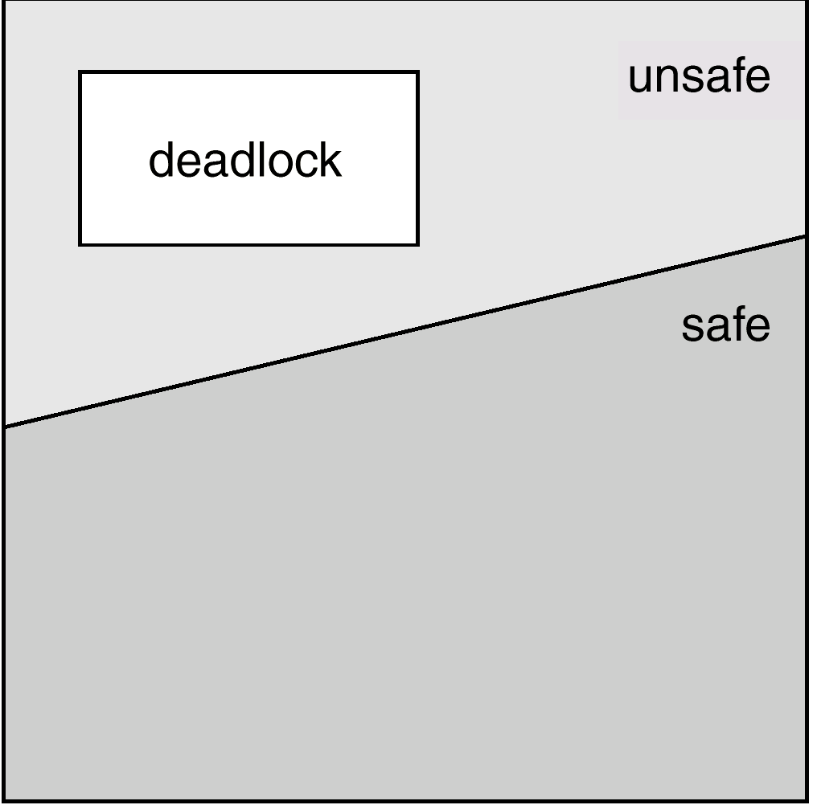
Safe, Unsafe , Deadlock State spaces

Slide 28
例
例：假如系统中有P1、P2和P3三个进程和12台磁带机。各进程最大需求和T0时刻分配状态如下：
进程 最大需求 已分配 还需请求 可用
P1 10 5 5 3 P2 4 2 2 P3 9 2 7
分析T0状态，是否可以找到一个安全序列，即系统按此进程序列分配资源，每个进程都可顺利完成。写出所有的安全序列。
如果在T0 状态不按安全序列进行分配，例如在T0状态下P3申请1台磁带机。如系统实施此次分配使系统状态由T0变为T1状态，分析T1状态安全情况。

Slide 29
Avoidance algorithms
Single instance of a resource type
Use a resource-allocation graph
Multiple instances of a resource type
Use the banker’s algorithm
Notes:
29

Slide 30
7.5.2 Resource-Allocation Graph Algorithm 资源分配图算法
Claim edge（需求边）P_{i} → R_{j} indicated that process P_{j} may request resource R_{j}; represented by a dashed line.
Claim edge converts to request edge（请求边）when a process requests a resource.
Request edge converted to an assignment edge （分配边） when the resource is allocated to the process
When a resource is released by a process, assignment edge reconverts to a claim edge.
Resources must be claimed a priori in the system.

Slide 31
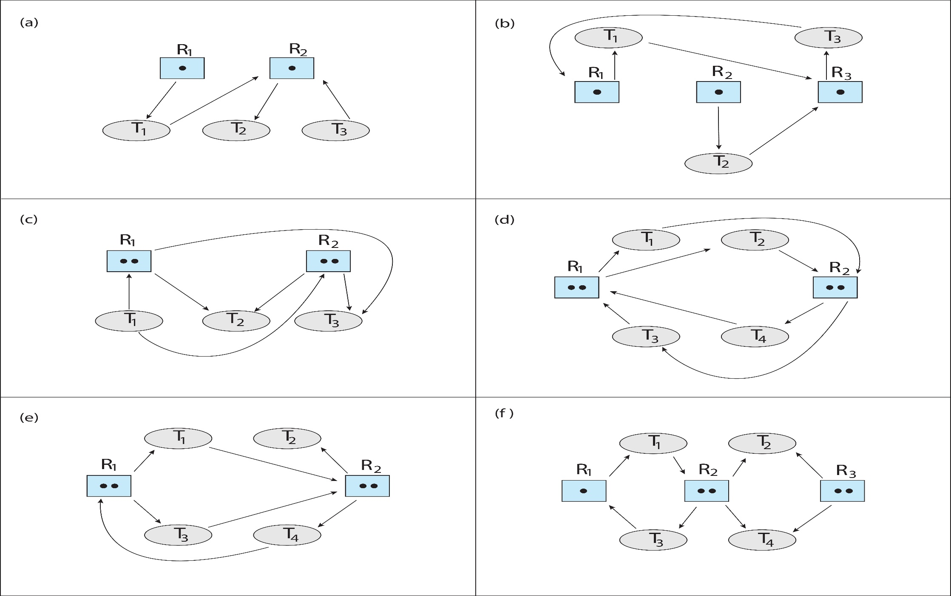
资源分配图

Slide 32
Resource-Allocation Graph Algorithm
算法：假设进程Pi申请资源Rj。只有在需求边P_{i} → R_{j} 变成分配边 R_{j} → P_{i} 而不会导致资源分配图形成环时，才允许申请。
用算法循环检测，如果没有环存在，那么资源分配会使系统处于安全状态。如果存在环，资源分配会使系统不安全。进程Pi必须等待。

Slide 33
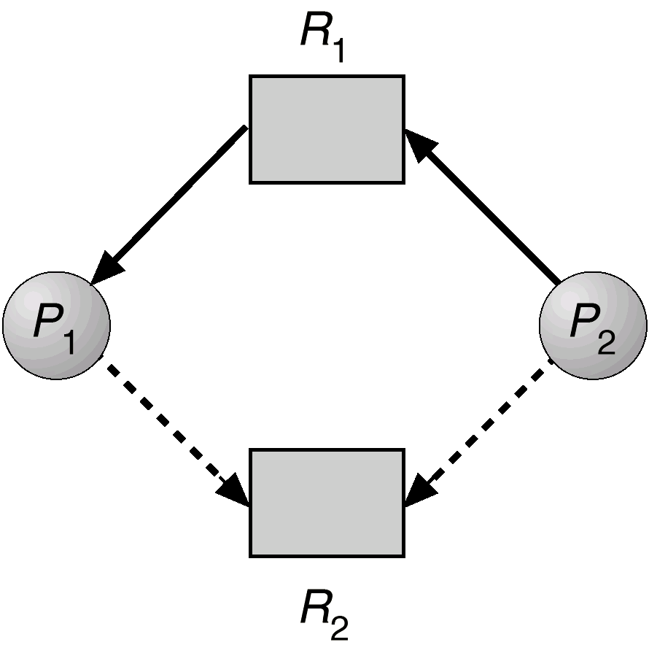
Resource-Allocation Graph For Deadlock Avoidance
Claim edge
P2 → R2
Claim edge
P1 → R2

Slide 34
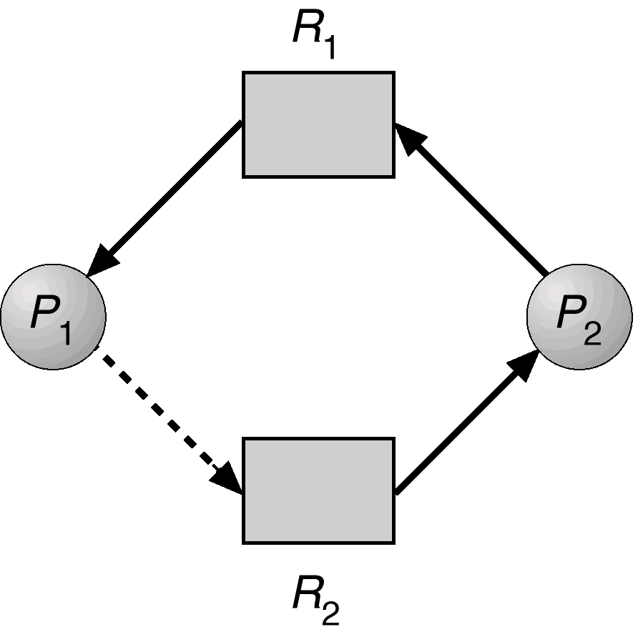
Fig 7.6 Unsafe State In Resource-Allocation Graph
P₂申请R₂后变成请求边，后变成分配边
存在环

Slide 35
7.5.3 Banker’s Algorithm（银行家算法）
Multiple instances
最具代表的避免死锁算法是Dijkstra的银行家算法，这是由于该算法用于银行系统现金贷款的发放而得名。
例：设银行家有10万贷款，P、Q、R分别需要8,3,9万元搞项目，如果P已申请到了4万，Q要申请2万，显然，如果满足Q的申请，有安全序列<P,Q,R>/<Q,P,R>。但如果R要申请4万，若满足R的申请，显然不存在安全序列。
Each process must a prior claim maximum use.
When a process requests a resource it may have to wait.
When a process gets all its resources it must return them in a finite amount of time.

Slide 36
Data Structures for the Banker’s Algorithm
Let n = number of processes, and m = number of resources types.
Available: Vector of length m. If available [j] = k, there are k instances of resource type R_{j} available.
Max: n x m matrix. If Max [i,j] = k, then process P_{i} may request at most k instances of resource type R_{j}.
Allocation: n x m matrix. If Allocation[i,j] = k then P_{i} is currently allocated k instances of R_{j.}

Slide 37
Data Structures for the Banker’s Algorithm (Cont.)
Need: n x m matrix. If Need[i,j] = k, then P_{i} may need k more instances of R_{j} to complete its task. Need [i,j] = Max[i,j] – Allocation [i,j].

Slide 38
7.5.3.1 Safety Algorithm安全算法
Let Work and Finish be vectors of length m and n, respectively. Initialize:
Work = Available
Finish [i] = false for i = 1,2,3, …, n.
2. Find an index i such that both:
(a). Finish [i] = false
(b). Need_{i} ≤ Work
If no such i exists, go to step 4.
3. Work = Work + Allocation_{i} Finish[i] = true go to step 2.
4. If Finish [i] == true for all i, then the system is in a safe state.

Slide 39
7.5.3.2 Resource-Request Algorithm
Request_{i} = request vector for process P_{i}. If Request_{i} [j] = k then process P_{i} wants k instances of resource type R_{j.}
1. If Request_{i} ≤ Need_{i} go to step 2. Otherwise, raise error condition, since process has exceeded its maximum claim.
2. If Request_{i} ≤ Available, go to step 3. Otherwise P_{i} must wait, since resources are not available.
3. Pretend to allocate requested resources to P_{i} by modifying the state as follows:
Available = Available - Request_{i};
Allocation_{i} = Allocation_{i} + Request_{i};
Need_{i} = Need_{i} – Request_{i} ;
Call Safety Algorithm
If safe ⇒ the resources are allocated to P_{i}.
If unsafe ⇒ P_{i} must wait, and the old resource-allocation state is restored

Slide 40
Example of Banker’s Algorithm
5 processes P₀ through P₄; 3 resource types A (10 instances), B (5 instances), and C (7 instances).
Snapshot at time T₀:
Allocation Max Available
A B C A B C A B C
P₀ 0 1 0 7 5 3 3 3 2
P₁ 2 0 0 3 2 2
P₂ 3 0 2 9 0 2
P₃ 2 1 1 2 2 2
P₄ 0 0 2 4 3 3
问： (1) State of system? (2) Can request for (1,0,2) by P1 be granted? (3) Can request for (3,3,0) by P4 be granted? (4) Can request for (0,2,0) by P0 be granted?

Slide 41
⑴ State of system?
Max Allocation Need Available work 分配前 释放后 Finish A B C A B C A B C A B C A B C A B C A B C P0 7 5 3 0 1 0 7 4 3 3 3 2 3 3 2 ④ 7 4 5 7 5 5 P1 3 2 2 2 0 0 1 2 2 ① 3 3 2 5 3 2 P2 9 0 2 3 0 2 6 0 0 ⑤ 7 5 5 10 5 7 P3 2 2 2 2 1 1 0 1 1 ② 5 3 2 7 4 3 P4 4 3 3 0 0 2 4 3 1 ③ 7 4 3 7 4 5
The system is in a safe state since the sequence < P₁, P₃, P₄, P₀, P₂> satisfies safety criteria.

Slide 42
(2) P₁ Request (1,0,2)
Check that Request₁(1,0,2)≤Need₁(1,2,2)， (that is true)
Check that Request₁ (1,0,2) ≤ Available (3,3,2), (that is true)
试探把资源分配给进程P1并修改有关数据结构的数值： Available = Available(3，3，2)－Request₁(1,0,2) ⇒ Available(2,3,0)； Need₁ = Need₁(1,2,2)－Request₁(1,0,2)= ⇒ Need₁(0,2,0)； Allocation₁ =Allocation₁(2,0,0)+Request₁(1,0,2) ⇒ Allocation₁(3,0,2)；
Call Safety Algorithm

Slide 43
(2) P₁ Request (1,0,2)
Max Allocation Need Available work 分配前 释放后 A B C A B C A B C A B C A B C A B C A B C P0 7 5 3 0 1 0 7 4 3 2 3 0 2 3 0 ④ 7 4 5 7 5 5 P1 3 2 2 3 0 2 0 2 0 ① 2 3 0 5 3 2 P2 9 0 2 3 0 2 6 0 0 ⑤ 7 5 5 10 5 7 P3 2 2 2 2 1 1 0 1 1 ② 5 3 2 7 4 3 P4 4 3 3 0 0 2 4 3 1 ③ 7 4 3 7 4 5
Executing safety algorithm shows that sequence <P₁, P₃, P₄, P₀, P₂> satisfies safety requirement.

Slide 44
(3) Can request for (3,3,0) by P₄ be granted?
Request₄(3,3,0)≤Need₄(4,3,1)，P4请求在最大需求范围内。
Request4(3,3,0)≤Available(2,3,0)不成立，即可用资源暂不能满足P4请求资源需要，P4阻塞等待。

Slide 45
(4) Can request for (0,2,0) by P₀ be granted?
Check that Request₀(0,2,0)≤Need₀(7,4,3)， (that is true)
Check that Request₀(0,2,0) ≤Available (2,3,0), (that is true)
试探把资源分配给进程P0并修改有关数据结构的数值： Available = Available(2，3，0)－Request₀(0,2,0) ⇒ Available(2,1,0)； Need₀ = Need₀(7,4,3)－Request₀(0,2,0) ⇒ Need₀(7,2,3)；
Allocation₀ =Allocation₀(0,1,0)+Request₀(0,2,0) ⇒ Allocation₀(0,3,0)；
Call Safety Algorithm

Slide 46
(4) P₀ Request (0,2,0)
Max Allocation Need Available work 分配前 释放后 A B C A B C A B C A B C A B C A BC A B C P0 7 5 3 0 3 0 7 2 3 2 1 0 2 1 0 P1 3 2 2 3 0 2 0 2 0 P2 9 0 2 3 0 2 6 0 0 P3 2 2 2 2 1 1 0 1 1 P4 4 3 3 0 0 2 4 3 1
Need_{i} > Work i=0,…,4 不安全
P0请求不能分配

Slide 47
7.6 Deadlock Detection

Slide 48
Deadlock Detection死锁检测
Allow system to enter deadlock state
Detection algorithm
Recovery scheme

Slide 49
7.6.1 Single Instance of Each Resource Type
Maintain wait-for graph 等待图—资源分配图的变形
Nodes are processes.
P_{i} → P_{j} if P_{i} is waiting for P_{j}.
Periodically invoke an algorithm that searches for a cycle in the graph.
An algorithm to detect a cycle in a graph requires an order of n² operations, where n is the number of vertices in the graph.

Slide 50
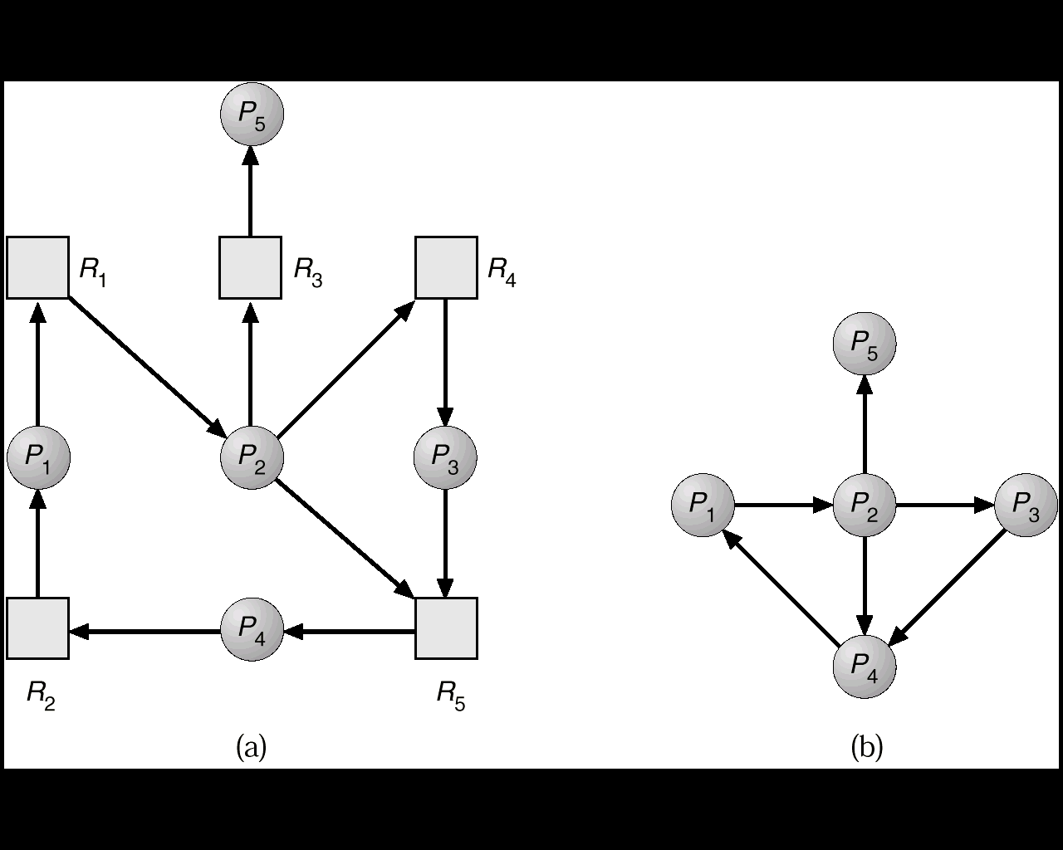
Fig 7.7 Resource-Allocation Graph and Wait-for Graph
Resource-Allocation Graph
Corresponding wait-for graph

Slide 51
7.6.2 Several Instances of a Resource Type
Data structures:
Available: A vector of length m indicates the number of available resources of each type.
Allocation: An n x m matrix defines the number of resources of each type currently allocated to each process.
Request: An n x m matrix indicates the current request of each process. If Request [i,j] = k, then process P_{i} is requesting k more instances of resource type.

Slide 52
Detection Algorithm
Let Work and Finish be vectors of length m and n, respectively Initialize:
(a) Work = Available
(b) For i = 1,2, …, n, if Allocation_{i} ≠ 0, then Finish[i] = false;otherwise, Finish[i] = true.
2. Find an index i such that both:
(a) Finish[i] == false
(b) Request_{i} ≤ Work
If no such i exists, go to step 4.

Slide 53
Detection Algorithm (Cont.)
3. Work = Work + Allocation_{i} Finish[i] = true go to step 2.
4. If Finish[i] == false, for some i, 1 ≤ i ≤ n, then the system is in deadlock state. Moreover, if Finish[i] == false, then P_{i} is deadlocked.
Algorithm requires an order of O(m x n²⁾ operations to detect whether the system is in deadlocked state.

Slide 54
Example of Detection Algorithm
Five processes P₀ through P₄; three resource types A (7 instances), B (2 instances), and C (6 instances).
Snapshot at time T₀
Allocation Request Available
A B C A B C A B C
P₀ 0 1 0 0 0 0 0 0 0
P₁ 2 0 0 2 0 2
P₂ 3 0 3 0 0 0
P₃ 2 1 1 1 0 0
P₄ 0 0 2 0 0 2
Sequence <P₀, P₂, P₃, P₁, P₄> will result in Finish[i] = true for all i.

Slide 55
Example (Cont.)
P₂ requests an additional instance of type C.
Allocation Request Available
A B C A B C A B C
P₀ 0 1 0 0 0 0 0 0 0
P₁ 2 0 0 2 0 2
P₂ 3 0 3 0 0 1
P₃ 2 1 1 1 0 0
P₄ 0 0 2 0 0 2
State of system?
Can reclaim resources held by process P₀, but insufficient resources to fulfill other processes requests.
Deadlock exists, consisting of processes P₁, P₂, P₃, and P₄.

Slide 56
7.6.3 Detection-Algorithm Usage
When, and how often, to invoke depends on:
How often a deadlock is likely to occur?
How many processes will need to be rolled back?
If detection algorithm is invoked arbitrarily, there may be many cycles in the resource graph and so we would not be able to tell which of the many deadlocked processes “caused” the deadlock.

Slide 57
7.7 Recovery from Deadlock

Slide 58
Recovery from Deadlock死锁恢复
检测到死锁后采取措施：
通知系统管理员
系统自己恢复
打破死锁两种方法：
进程终止
抢占资源

Slide 59
7.7.1 Process Termination
Abort all deadlocked processes.
Abort one process at a time until the deadlock cycle is eliminated.
Many factors may determine which process is chosen,include:
Priority of the process.
How long process has computed, and how much longer to completion.
Resources the process has used.
Resources process needs to complete.
How many processes will need to be terminated.
Whether the process is interactive or batch.

Slide 60
7.7.2 Resource Preemption
Selecting a victim – minimize cost最小化代价
Rollback（回退）– return to some safe state, restart process from that state.
Starvation – same process may always be picked as victim, include number of rollback in cost factor.

Slide 61
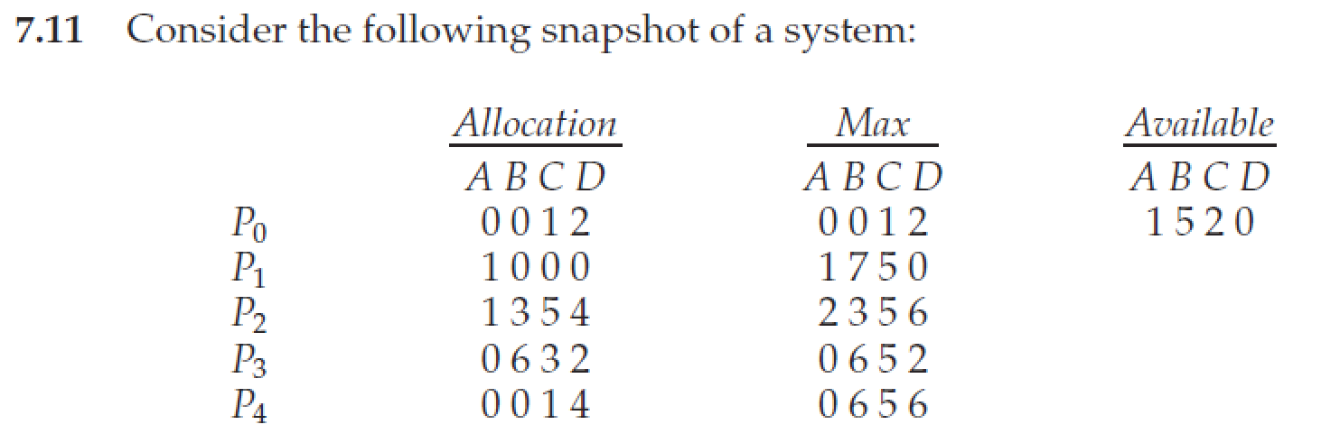
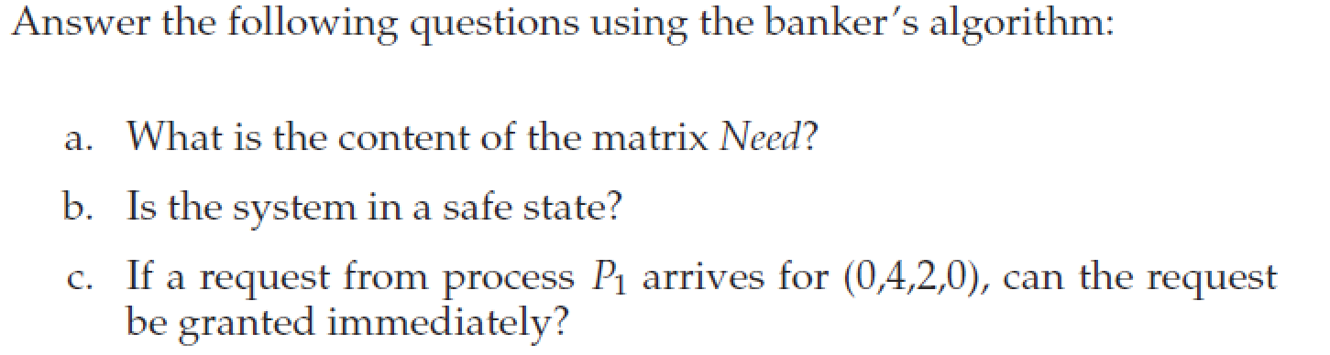
课堂练习

Slide 62
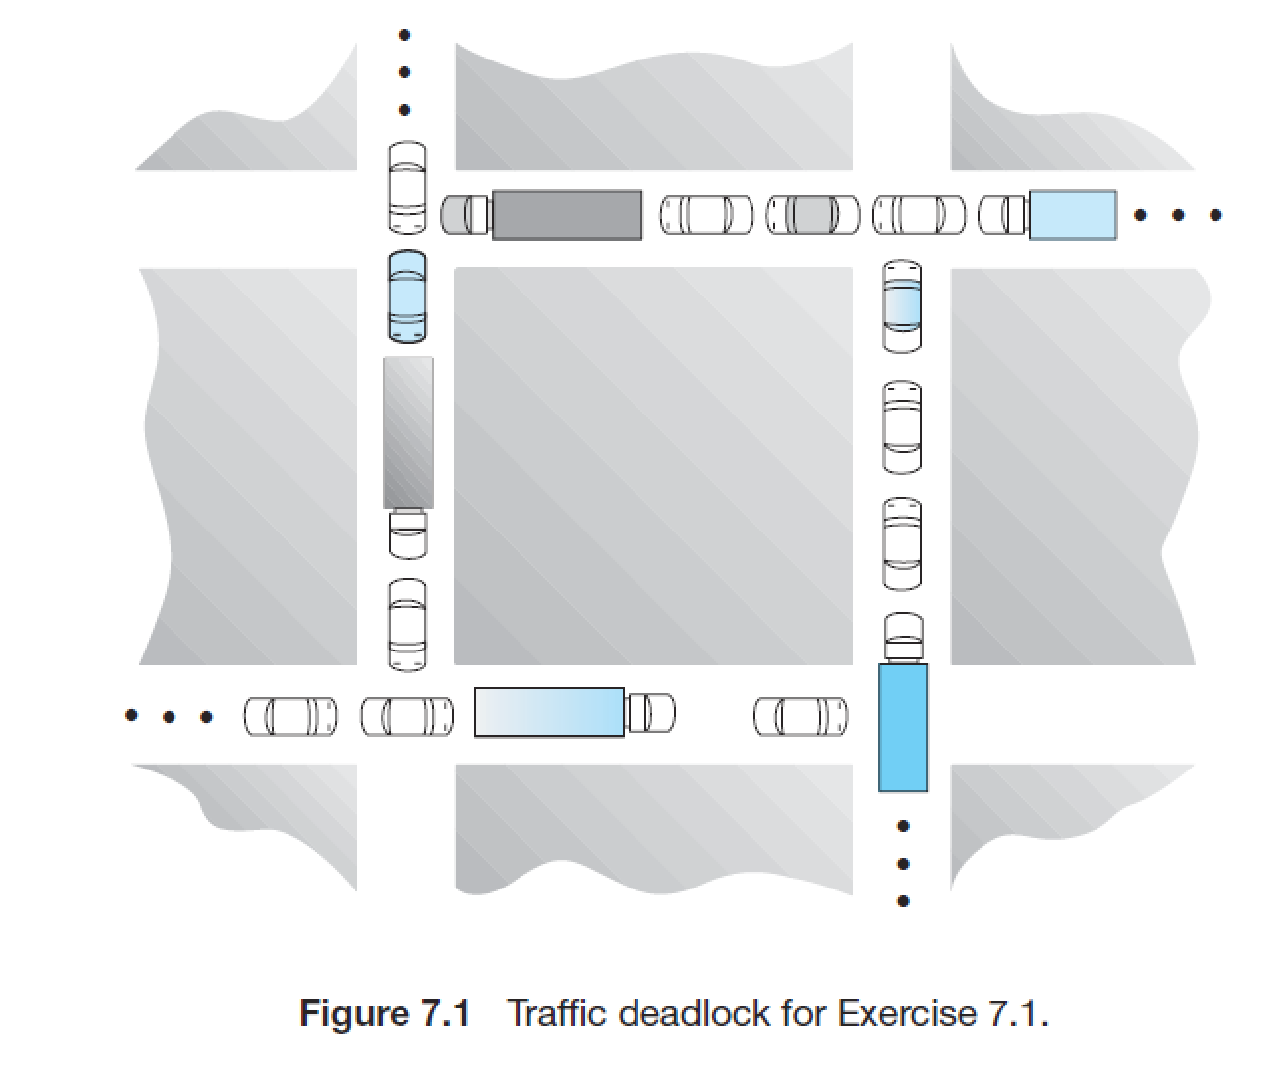
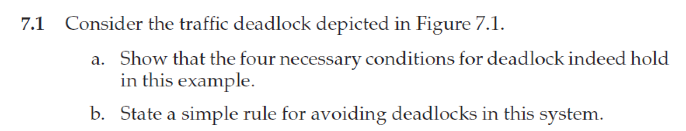
Homework
书后习题7.1、7.2、7.6、7.7、7.11

Slide 63
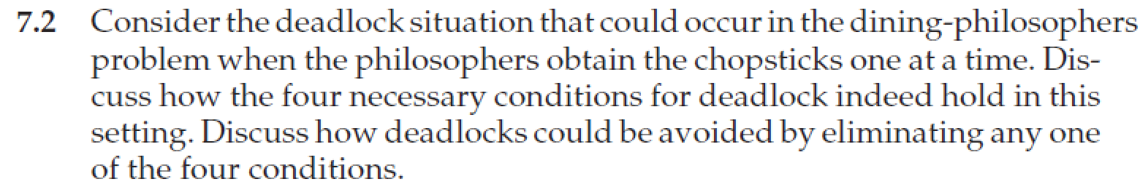
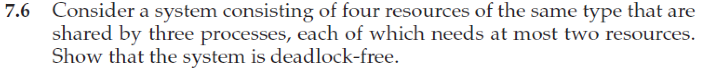
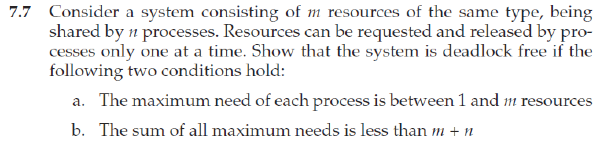
Homework
11月24日晚上12点前提交作业
上传文件时，"名字"填"作业1"、"作业2" 等，"姓氏"请填"个人姓名“
文件名以“学号-姓名-作业x”命名，例如“3170100000-张三-作业1”
有问题可询问TA曾奕久 18888921519 22221190@zju.edu.cn

